Slide 1
DOELAP Webinar
January 22, 2026
Steve Bohrer, Senior Technical Manager for DOELAP
Radiological and Environmental Sciences Laboratory

Slide 2
DOELAP Purpose
The Department of Energy (DOE) implemented the DOE Laboratory Accreditation Program (DOELAP) for personnel dosimetry in 1986 and for radiobioassay in 1998. The objective of DOELAP is to assure the competency of dosimetry and radiobioassay measurements, provide calibration intercomparisons, perform site assessments, and encourage applied research in areas where there is a technology shortfall. DOE also expects the program to enhance cooperation and technical information exchange among its sites and facilities in order to provide a more standardized and uniform radiation dosimetry capability. DOE sites and facilities are expected to use standards and other technical guidance from DOE to ensure that the performance of personnel dosimetry and radiobioassay measurements are adequate to meet the standards of Title 10, Code of Federal Regulations, Part 835, Occupational Radiation Protection and related documents.

Slide 3
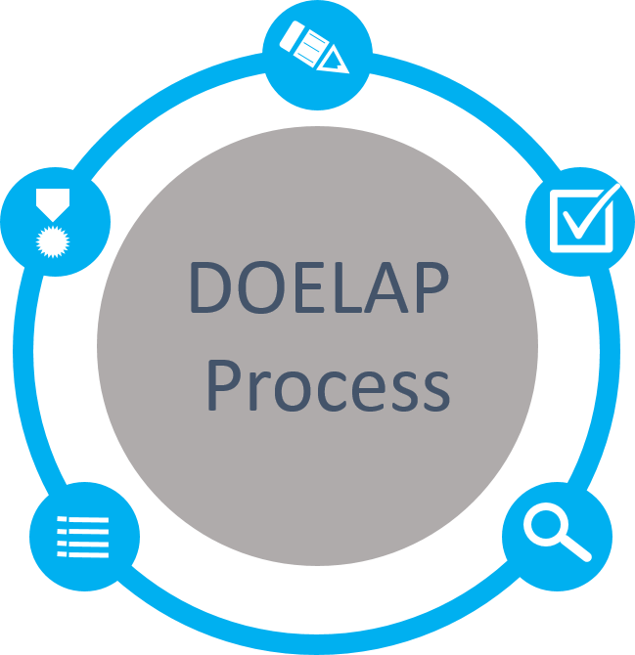
DOELAP Process
Application
Categories based on site requirements
Quality Assurance Program
Field Office Review
Performance Testing
ANSI N13.11, Personnel Dosimetry Performance Criteria and Testing
ANSI N13.32, Performance Testing for Extremity Dosimeters
ANSI N13.30, Performance Criteria for Radiobioassay
Accreditation
Period of 3 years
Notify DOELAP of changes
Memo goes to Field Office
Oversight Board Review
Complete Package
Recommendations to Administrator
On-Site Assessment
Direct observation and evaluation
Conducted by technical experts

Slide 4
DOELAP Standards
DOE-STD-1111-20XX, DOELAP Administration
RevCom currently on hold
Was in concurrence phase
DOE-STD-1112-2019, DOELAP for Radiobioassay
Tentatively planning to draft revisions this year
Publication dependent on RevCom
DOE-STD-1095-2025, DOELAP for Personnel Dosimetry
Went into effect January 21, 2025
Programs have 1 year to implement

Slide 5
Document control
DOE-STD-1112-2019 4.4(b)
All documents that form the quality assurance program shall be controlled to ensure that the correct documents are being employed. Documents shall be reviewed for accuracy and approved by authorized personnel in accordance with documented review frequencies.
DOE-STD-1095-2025 4.5(b)
Documents required by the QAP shall be controlled to ensure that the correct and most current documents are being utilized. QA documents shall be reviewed for accuracy and approved by authorized personnel in accordance with documented internal review frequencies.
No required periodicity
Sites define the review frequency, then do it

Slide 6
DOE-STD-1112-2019 3.2(e) DOE-STD-1095-2025 3.2(e)
The applicant shall review the performance testing data for potential improvements in the radiobioassay (or dosimetry) measurement system.
Management reviews
Trending over time
Collaboration between vendor users

Slide 7
Modifications to an Accredited Program
Actions to be taken
Routine maintenance, where the processes and quality control are formally documented in the program’s quality assurance manual or supporting documentation, is not considered a program modification (DOE-STD-1111-2018 5.4(b))
STM shall be notified whenever changes are made to key personnel, processes, procedures, equipment, facilities, software, or other systems that were listed in the application for accreditation (DOE-STD-1111-2018 5.4(a))
Formal request for Technical Equivalence
Formal request for Amendment
Call the STM to discuss and get started

Slide 8
Technical Equivalence vs. Amendment
TE – significant modifications to accredited program
Changes to algorithm, changes to critical software, etc.
Amendment – change to scope of accreditation, conditions of accreditation
New measurement processes, new categories, etc.
Both follow the same process
Documentation to support the request routed through DOE Field Office to the STM for review
DOELAP Administrator makes a final determination and notification.
The DOELAP STM or the DOELAP Administrator may require additional information or verifications to be performed before granting technical equivalence

Slide 9
Redundant Measurement Capabilities (4.2.1)
The DOE Standard requires programs to develop plans to address temporary and unexpected loss of capability to deliver DOELAP-accredited personnel dosimetry services.
This includes:
Reliance on external vendors;
On-site duplicate measuring systems;
Inter-site collaborations.

Slide 10
External Vendor Services (e.g., Landauer)
Landauer is Vendor Qualified and has demonstrated its backup systems meet DOE-STD-1095 requirements.
A program that utilizes dosimetry services from Landauer provides oversight of Landauer.
Part of the oversight should include evaluating Landauer’s backup facility (or duplicate monitoring system) capabilities.

Slide 11
Duplicate Measuring System (4.2.1(b))
Backup reader(s) are similar in configuration to primary readers.
Maintenance (calibration, linearity, QC, preventative maintenance) should be consistent with primary systems.
Evidence (log books, calibration records, QC data) demonstrates functional equivalency.

Slide 12
Inter-Site Processing (Site A to Site B) a couple of general scenarios
Site A ships their dosimeters to Site B for processing
Site B can be interpreted to be a duplicate measuring system (4.2.1(b)).
Site A is responsible for demonstrating equivalent performance of Site B's system for all accredited categories.
This most likely involves initial studies with irradiated dosimeters and development of correction factors, consideration of reader setup and calibration, etc.
Ongoing readiness requires periodic blind testing of Site B's system by Site A.
Site B does not require DOELAP accreditation in the same categories as Site A

Slide 13
Inter-Site Processing (Site A to Site B)
Site A plans to use the dosimetry services provided by Site B.
In this scenario, Site B is a “backup” service provider, 4.2.1(c), and acts like a vendor for Site A, providing dosimeters, processing dosimeters, and providing results
Site B has a DOELAP accreditation, but Site B is not required to maintain accreditation for the same categories as Site A.
Site A is responsible for documenting that Site B has demonstrated acceptable performance in all accredited categories identified in the agreement.
Site A is responsible for ongoing blind testing of Site B, leveraging Site B's own blind testing results where applicable, but covering categories where Site B does not routinely test.

Slide 14
Guidance for Sites and Assessors
If a site has thought through possible (but not unrealistic) scenarios; performed appropriate studies; developed correction factors, transfer protocols, etc; and documented the process the intent of the Standard is being met.
Sites are encouraged to contact the DOELAP STM for guidance on evaluating their own programs.
The STM can assist with complex or unique program situations not explicitly detailed in general guidance
Assessors should contact the DOELAP Senior Technical Manager (STM) for questions or concerns during assessments.

Slide 15
Continuity of Operations Radiobioassay
DOE-STD-1112-2019 4.2(h) A program shall have a documented plan for continuity of operations. This includes service contracts, in-house maintenance, spare parts capabilities, and unexpected loss of key personnel.
There will be additional clarifications in this section.
DOELAP recognizes there are differences between radiobioassay and personnel dosimetry

Slide 16
Continuity…for the near term
How to meet requirements
MOAs
On site backup
Alternative methods, emergency plans
Personnel cross training, corporate reach back, etc.
Concern
No plan, agreement not renewed within accreditation period (if utilizing backup agreement), spare parts or maintenance capability not in place.
Observation
Plan or agreement in place, not comprehensive, plans may lack detail

Slide 17
Common questions
Group assessments of DOELAP-Qualified Vendors
Both 1095 and 1112 include essentially the same requirements:
The DOELAP accredited program has the responsibility for ensuring the requirements of this technical standard are met.
The program shall have a procedure for conducting quality assurance assessments of the service provider; that includes on-site audits, quality control reviews, and blind quality control [audit dosimeters]. The procedures shall also describe how findings are identified and corrected.
DOELAP checklist? DOELAP Vendor Qualification assessment report? Individual SOW requirements

Slide 18
Common questions
Observation of work performance
The Technical Lead shall initially and at least annually evaluate and document the proficiency of each staff member authorized to perform dosimetry-related functions. When appropriate, this proficiency assessment should include an observation of performance. DOE-STD-1095-2025 4.4(d)
Previous language was “shall”
Other questions – where the DOELAP Standards are not specific or don’t address the particular topic, DOELAP gives latitude to site needs.

Slide 19

Contacts
https://resl.id.energy.gov/doelap/doelap.html
One-stop-shop for DOE Standards, assessment checklists, webinar presentations, etc.
Steve Bohrer, STM-DOELAP
bohrerse@id.doe.gov
Shane Steidley, STM-Chemistry
steidlsd@id.doe.gov
Guy Backstrom, RESL Director
backstlg@id.doe.gov
Questions?

